Slide 1
System Level Tests
By Paul Darr

Slide 2
Topics
What is it?
Purpose of Testing
Testing Best Practices
Types of Testing
Testing Roles and Responsibilities
Test Script – Tests and Documentation

Slide 3
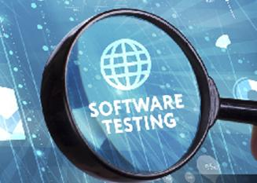
What is it?
System testing of software or hardware is testing conducted on a complete, integrated system to evaluate the system's compliance with its specified requirements. System testing falls within the scope of black-box testing, and as such, should require no knowledge of the inner design of the code or logic. System testing is performed on the entire system in the context of a Functional Requirement Specification(s) (FRS) and/or a System Requirement Specification (SRS). System testing tests not only the design, but also the behaviour and even the believed expectations of the customer.

Slide 4
Purpose of Testing
Check that configuration and code is functional
Ensure that the system’s initial build meets the agreed requirements
Help to control the project scope
Confirm that the finished system can support the client’s business
processes
Gain client’s approval to release new functionality for general use

Slide 5
Testing Best Practices
What it should not be used for:
Making changes to business processes
Introducing additional requirements outside of scope
Making significant cosmetic changes to page layouts and user interface
Training users
What it should be used for:
Rely Only on a Controlled Security Environment for Testing
Carry Tests Throughout the Software Development Cycle
Break Tests in Small Fractions
Programmers Should Not Write Tests
Carry Regression Tests

Slide 6
Types of Testing
Graphical user interface testing
Usability testing
Software performance testing
Compatibility testing
Exception handling
Load testing
Volume testing
Stress testing
Security testing
Scalability testing
Sanity testing
Smoke testing
Exploratory testing
Ad hoc testing
Regression testing
Installation testing
Maintenance testing
Recovery testing
Accessibility testing

Slide 7
Types of Testing
Graphical user interface testing
In software engineering, graphical user interface testing is the process of testing a product's graphical user interface to ensure it meets its specifications. This is normally done through the use of a variety of test cases.
Usability testing
Usability testing is a technique used in user-centered interaction design to evaluate a product by testing it on users.

Slide 8
Types of Testing
Security testing
Security testing is a process intended to reveal flaws in the security mechanisms of an information system that protect data and maintain functionality as intended.
Accessibility
In human–computer interaction, computer accessibility (also known as accessible computing) refers to the accessibility of a computer system to all people, regardless of disability type or severity of impairment.

Slide 9
Testing Roles and Responsibilities
Project Manager:
Coordinates script writing
Schedules testing time around day jobs
Ensures testers are testing when they are scheduled to
Co-ordinate testing sign off
Business Owners:
Write test scripts in accordance with usual business processes
Sign off testing
Testers:
Follow test scripts, adding comments and incidents
Retest following fixes
Specify whether each process is a test PASS or FAIL

Slide 10
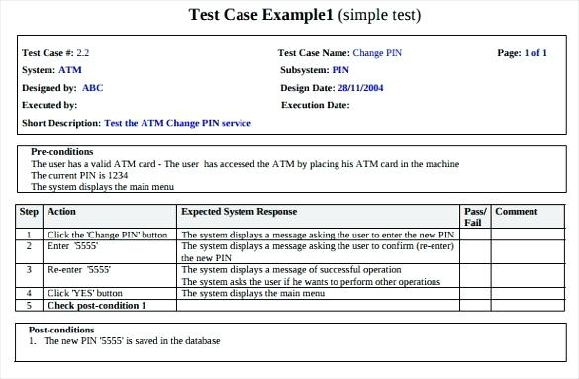
Test Scripts
Tests define what process is being tested, steps to follow, expected vs actual results, overall test pass/fail and comments.

